Slide 1
XML
Introduction to XML Schema
LEVEL – PRACTITIONER

Slide 2
About the Author
Created By: | Shanmu (105110)
Credential Information: | Sr Architect.
Version and Date: | 1.0, November 22’nd 2011
Cognizant Certified Official Curriculum
Notes:
For the animators:
This screen content needs to be rendered in the flash, no animations needed.

Slide 3
Session Objective
After completing this chapter you will be able to understand:
What is a schema?
Difference between DTD and Schema.
How to create a XSD for a XML File.

Slide 4
What is a Schema
An XML Schema describes the structure of an XML document.
XML Schema is an XML-based alternative to DTDs.
The XML Schema language is also referred to as XML Schema Definition or XSD.
The purpose of an XML Schema is to define the legal building blocks of an XML document.
XML Schema defines the elements, attributes and their data types that can appear in an XML document.
The schema files are stored with extension “.xsd”
Example: Employee.xsd

Slide 5

DTD Vs XML
Confused between DTD and XSD. Lets look at the difference in the end of the session.

Slide 6

What is a name space?
Lets take a real world analogy.
Assume there are two varieties of apples one from US and other from India.
USA
India
Both the apple looks similar, If you mix the apples you will end up with a confusion to differentiate the varieties.
The box where they are placed helps us to differentiate them.

Slide 7
What is a name space?
Name Space are similar to the boxes mentioned in the previous slide.
Name space are packages (apple box) to group the elements and specify a prefix to access them.
Name space helps to avoid element name conflicts. That is there could be two elements with the same name in two different name spaces (like US and Indian apples in their appropriate boxes).

Slide 8
What is a name space?
Name space are like java packages where two classes having the same name can be differentiated by the package they are present.
Example: Two classes EmployeeSalary.java can be differentiated using their packages they reside
com.cts.employee
com.cts.employee.finance
The namespaces and their prefixes can be specified as follows:
xmlns:emp=“http://www.abc.com”
A namespace can be anything not just an URL.
A single XML document can have elements from multiple namespaces.

Slide 9
Name space explained with a XML
Lets assume a fruit XML, which has a collection of Indian and US apples.
<Fruit>
<Apple>
<color>Red</color>
<taste>Sweet</taste>
</Apple>
<Apple>
<color>Yellow</color>
<taste>Sweet</taste>
</Apple>
</Fruit>
We have a name conflict of the element <apple> we will not be able to differentiate which is Indian (or) US apple
Next Slide we will see how to resolve it.

Slide 10
Name space explained with a XML
Lets see how we can resolve the problem.
<xsd:schema xmlns:ind=http://www.fruits.com/India
xmlns:us=http://www.fruits.com/US>
<Fruit>
<ind:Apple>
<color>Red</color>
<taste>Sweet</taste>
</ind:Apple>
<us:Apple>
<color>Yellow</color>
<taste>Sweet</taste>
</us:Apple>
</Fruit>
The two name spaces are defined with indicator “ind” representing India and “us” for USA.
The indicator “ind” and “us” are then used along with the XML element to differentiate US and indian apple tags.

Slide 11
Elements Of Schema
Element are building blocks of XSD used for defining the structure, data types of XML.
The following are the elements of XSD,
Schema element
Simple element
Complex type
Attribute
Indicators

Slide 12
Lets take a sample XML to learn XSD
Lets take a sample XML to learn XSD,
<Earth>
<Continent comment=“captures the continent details” >
<ContinentName>Asia</ContinentName>
<description>Asian continent</description>
<Countries >65</Countries>
</Continent>
<Continent comment=“captures the continent details” >
<ContinentName>Africa</ContinentName>
<description>African continent</description>
<Countries >45</Countries>
</Continent>
</Earth>

Slide 13
Schema Element
The <schema> element is the root element of every XML Schema.
Where,
xmlns:xs="http://www.w3.org/2001/XMLSchema" - This indicates that all the element and data types (like complex, simple, Integer, string) used in this XSD are defined in http://www.w3.org/2001/XMLSchema name space. “xs” is the prefix of the name space.
targetNamespace="http://www.cognizant.com" - This indicates that the elements to be defined in this schema belong to http://www.cognizant.com namespace.
xmlns="http://www. cognizant.com - This refers to the default name space, elements used without prefix uses this name space.
Syntax:
<xs:schema xmlns:xs="http://www.w3.org/2001/XMLSchema" targetNamespace="http://www.cognizant.com" xmlns="http://www. cognizant.com" > ... </xs:schema>

Slide 14
Simple Element
A simple element,
Contains only text
It can not contain any other elements or attributes
Syntax: <xs:element name=“name of the element" type=“data type of element like String, date, integer."/>
Taking our XML example:
<ContinentName>Asia</ContinentName>
<Countries >65</Countries>
Simple element Definition:
<xs:element name=“ContinentName" type="xs:string"/>
<xs:element name=“Countries" type="xs:integer"/>

Slide 15
Simple Element – Default Value
A simple element, can contain a default value, a value which can be substituted when no values is specified.
Default Value Example:
<xs:element name=“ContinentName" type="xs:string“ default=“Australia”/>
Input XML :
<ContinentName></ContinentName>
Output XML once XML is parsed using XSD:
<ContinentName>Australia</ContinentName>
In the example, since the continent name is empty it will be defaulted to “Australia” by the xml parser.

Slide 16
Simple Element – Fixed Value
A simple element, can contain a fixed value, a constant value which can be specified , which cannot be changed.
Fixed Value Example:
<xs:element name=“ContinentName" type="xs:string“ fixed=“Africa”/>

Slide 17
Complex Element
A complex element is a element that,
Contains other elements (Simple/complex)
Contain attributes.
Taking our XML example:
<Earth>
<Continent comment=“captures the continent details” >
<ContinentName>Asia</ContinentName>
<Countries >65</Countries>
</Continent>
<Earth>
Element “Earth” & “Continent” has other elements so they are complex elements.
We will learn about attribute in the next slide.

Slide 18
How to define a Complex Element
How continent element is defined?
<xs:complexType name=“ContinentInfo"> <xs:sequence> <xs:element name="ContinentName" type="xs:string"/> <xs:element name=“Countries" type="xs:integer"/> </xs:sequence> </xs:complexType>
<xs:element name=“Continent" type=“continentInfo"/>
Step 1: <xs:complexType name=“ContinentInfo"> - This creates a data type continent info object.
Step 2: <xs:element name=“Continent" type=“continentInfo"/> - This creates the complex element Continent with data type continent info. <sequence> indicator - This means that the child elements (ContinentName, Countries) must appear in the XML the same order as they are declared.

Slide 19
Element Attributes
Attributes can be defined for complex elements.
Syntax: <xs:attribute name=“attribute name" type=“data type"/>
Taking our XML example: Lets define attribute for the element Continent,
<Continent comment=“captures the continent details” >
Here “comment” is the attribute of a complex element “Continent”.

Slide 20
How to define Attributes
<xs:attribute name=“comments" type=“xs:string"/>
<xs:complexType name=“ContinentInfo"> <xs:sequence> <xs:element name="ContinentName" type="xs:string"/> <xs:element name=“Countries" type="xs:integer"/> </xs:sequence>
<xs:attribute ref=“comments” /> </xs:complexType>
<xs:element name=“Continent" type=“continentInfo"/>
Step 1: Define the attribute
Step 2: Define the Complex object.
Step 3: Add the attribute reference in the complex object.

Slide 21
Indicators
There are seven indicators falling under three categories,
Indicators
Order
All
Choice
Sequence
Occurrence
Max Occurs
Min Occurs
Group
Group Name
Attribute Group
These are used for defining the order of the elements
These are used for defining how many times a element can occur in a XML
These are used for grouping elements & attributes.

Slide 22
All Indicator
<xs:complexType name=“ContinentInfo"> <xs:all>
<xs:element name="ContinentName" type="xs:string"/> <xs:element name=“Countries" type="xs:integer"/>
</xs:all>
</xs:complexType>
This signifies that the elements “continentName” and “countries” can appear in any order and can come only once.

Slide 23
Choice Indicator
<xs:complexType name=“ContinentInfo"> <xs:choice>
<xs:element name="ContinentName" type="xs:string"/> <xs:element name=“Countries" type="xs:integer"/>
</xs:choice>
</xs:complexType>
This signifies that only one of the child elements can appear. So it is either “continentName” (or) “countries” child element under the “Continent“ element.

Slide 24
Sequence Indicator
<xs:complexType name=“ContinentInfo"> <xs:sequence>
<xs:element name="ContinentName" type="xs:string"/> <xs:element name=“Countries" type="xs:integer"/>
</xs:sequence>
</xs:complexType>
This signifies that the elements should always be in the order specified “continentName” followed by “countries”

Slide 25
Min and Max occurs Indicator
<xs:complexType name=“ContinentInfo"> <xs:sequence>
<xs:element name="ContinentName" type="xs:string“ maxOccurs="10“ minOccurs=“2” /> <xs:element name=“Countries" type="xs:integer"/>
</xs:sequence>
</xs:complexType>
This signifies the element “continentName “ should appear at least twice inside the continent element and cannot exceed beyond 10.

Slide 26
Lend a Hand: Creating a XSD
Using the next slide as reference the associates needs to create the same XSD using a notepad.

Slide 27
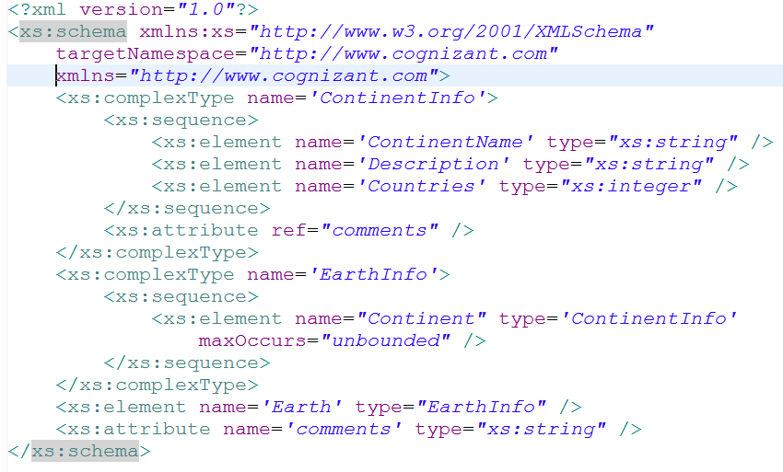
Lend a Hand: Complete XSD for the XML

Slide 28
Lend a Hand: XML generation from XSD using SDE
Follow these steps to create a XML from XSD using eclipse,
Open SDE and create a java project.
Create a empty XSD, Select the project and click CTRL+N and select XML Schema from XML group.
Follow the wizard and create a blank XSD.
Copy/paste the XSD you created in notepad into the blank XSD.
Right click XSD in the project explorer and click validate in context menu, it should not throw errors.
Right click XSD in the project explorer and click generate – This will create the sample XML for the XSD created.
NOTE: If the following line is not included in the beginning of XSD, the generate feature would not appear in the context menu.
<?xml version="1.0"?>

Slide 29

Few Tips
Using SDE/Eclipse you can do lots of things easily like,
Create DTD/ XSD in design view.
Generate XSD/DTD from XML.
Validate existing XSD/DTD.
Generate XML from DTD and XSD.
Explore these in your free time for developing/validating XML related files with ease.

Slide 30
XSD Vs DTD
XSD | DTD
XSD supports data types like String, integers. So one can restrict the XML content of an element. | DTD does not support data types. Therefore, you cannot restrict the XML content of an element.
XSD supports default values for elements. | DTD does not support default values for elements.
XSD supports references to external XML schemas. | You cannot include other DTDs within a DTD.
XSD has a XML structure which is easy to maintain. | DTD has a flat file structure which is complex to maintain.

Slide 31

Time To Reflect
Associates to reflect the following topics before proceeding.
What is a XSD?
What is the significance of a name space?
What are all the XSD elements you learnt?
What is the difference between simple and complex elements?
What is a schema element?
What are the types of indicators?

Slide 32
Step By Step approach to create a XSD
These are the steps to create a XSD for an XML.
Step 1: Create root tags schema tags & name spaces.
Step 2: Identify simple elements.
Step 3: Identify attributes.
Step 4: Identify complex elements.
Step 5: Collate the details and create a XSD.

Slide 33
Hands on Exercise: Create a XSD
You can use the Earth demo for reference to develop the XSD. Finally validate the XSD and generate a XML using SDE.
For the shopping complex online application XML file create a XSD by following the steps.
List of Products
Products can have one or more products
Each product should have the following elements, there is no specific order needs to be followed for elements.
Product Name - String
Product Description – String, Should have a default value “generic product”
Product Type (Grocery/Apparel/Electronics) - String.
Quantity – Integer.
The product element should have an attribute “id” – integer.
The elements defined in the schema should have a name space “www.cognizant.com/schema”

Slide 34
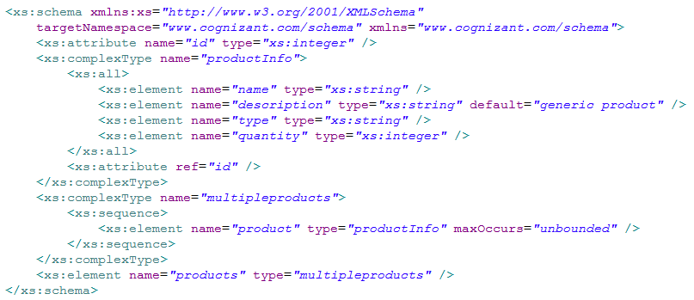
Try it Out: Solution
Solution:

Slide 35
XML
You have successfully completed -
Introduction to XML Schema

